Slide 1
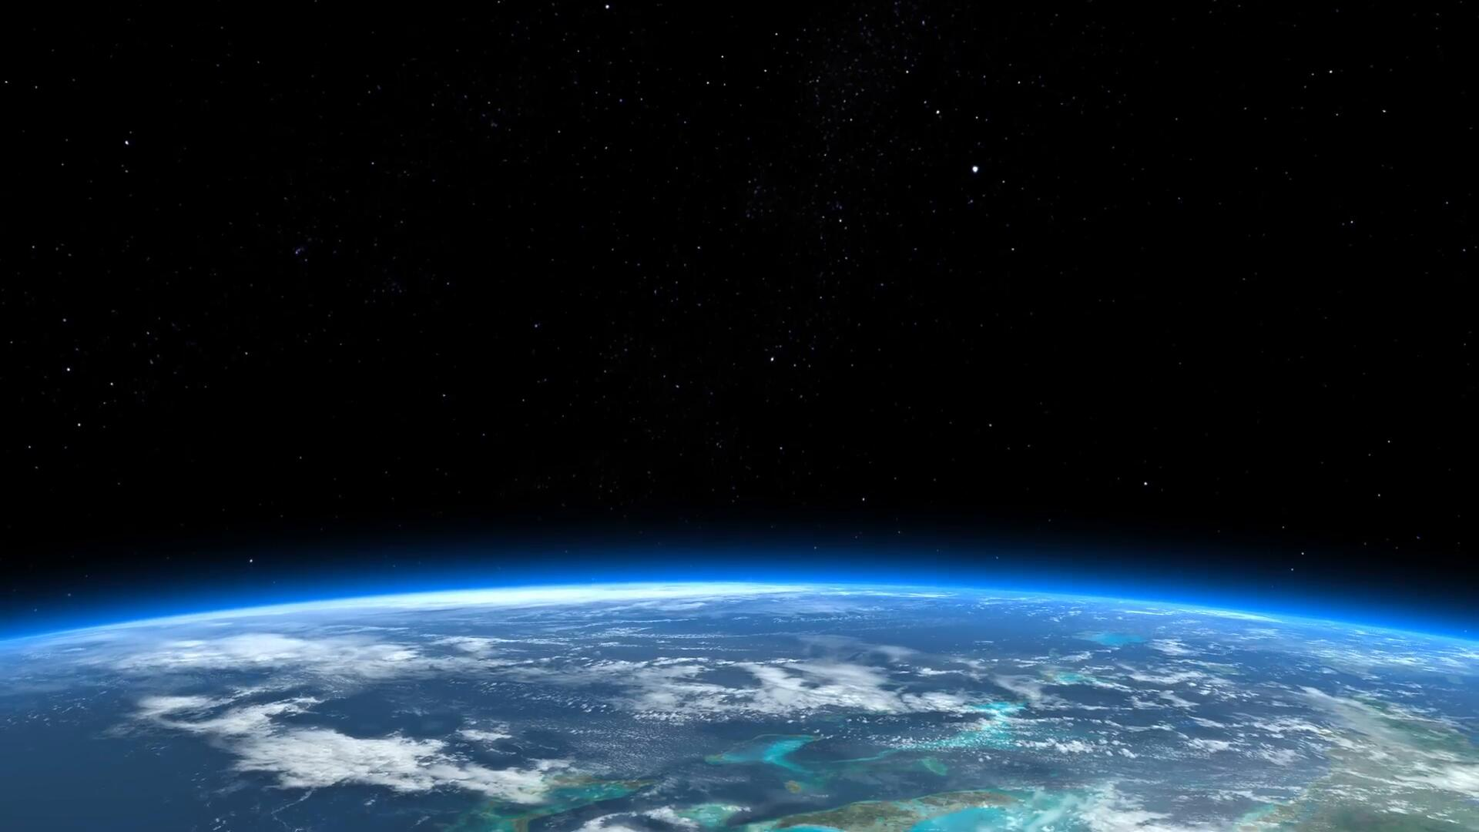

EXPLORING “ARRIVAL” (2016) THROUGH THE LENS OF NLP.
TEAM: FUTURE WIZARDS OF AI

Slide 2

Exploring Language and Communication in "Arrival"
A Glimpse into the Complexity of Human-Extraterrestrial Interaction
"Arrival" delves into first contact with extraterrestrials, focusing on linguist Louise Banks' efforts to understand their language. Arrival" is a science fiction film that explores themes of communication, language, and understanding. It revolves around the arrival of extraterrestrial spacecraft on Earth and the efforts to communicate with the aliens, known as Heptapods.

Slide 3
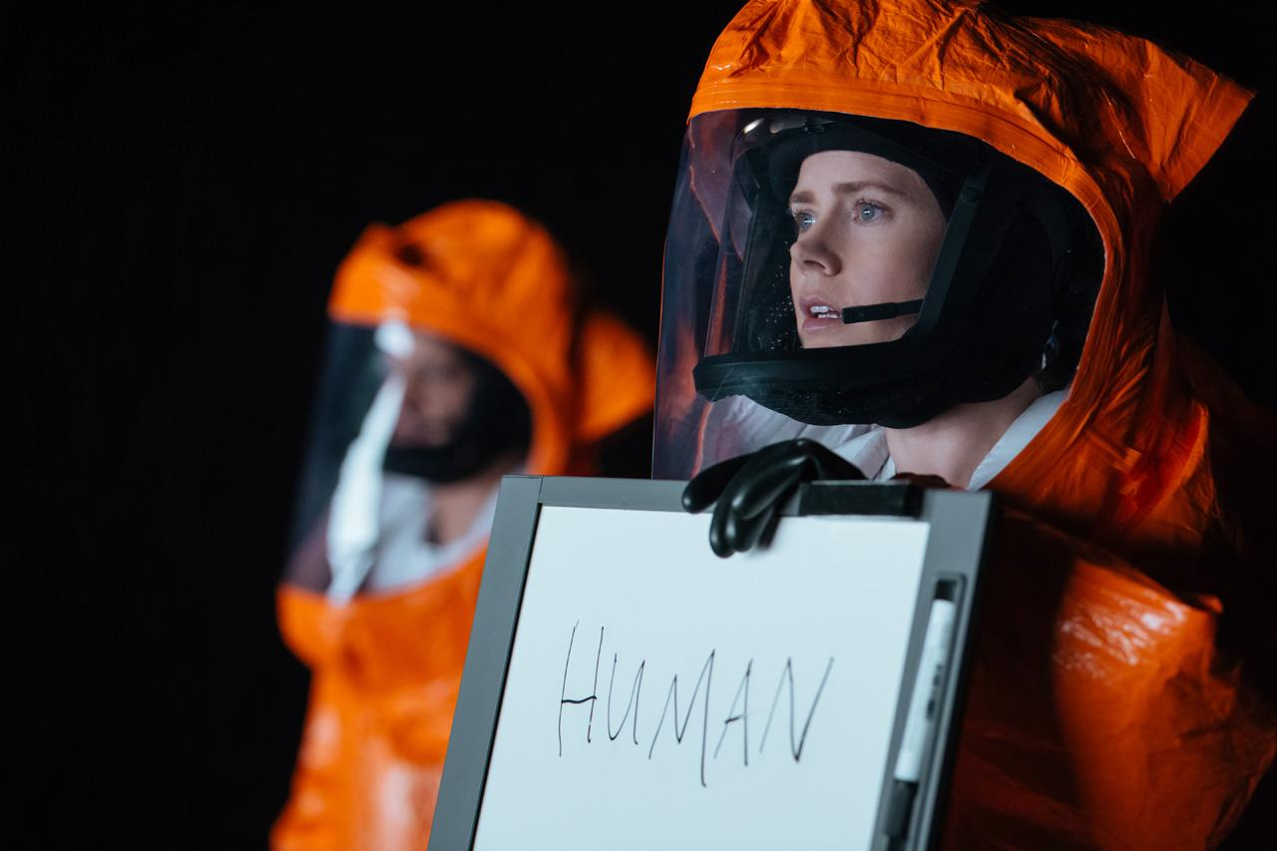
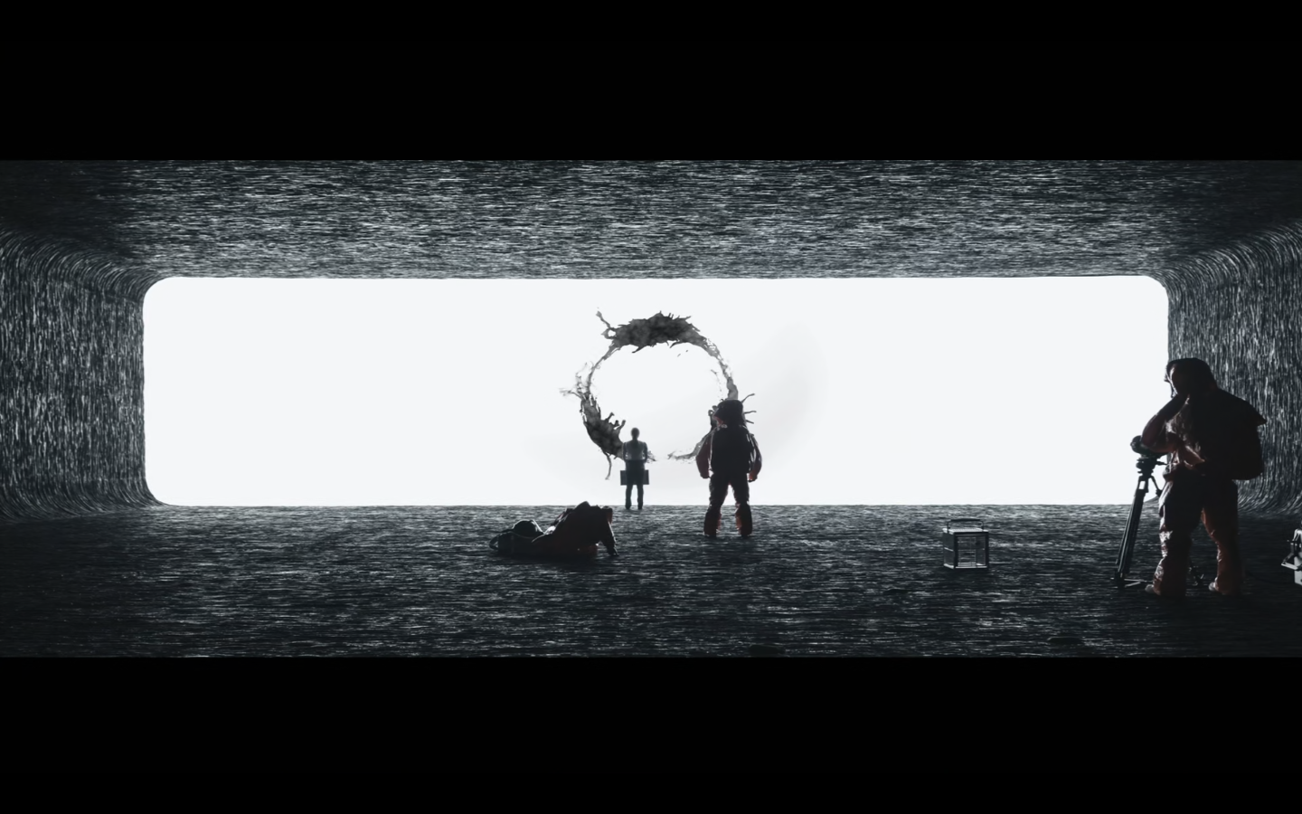
Analysis of Communication Methods
Deeper Insights into "Arrival" and NLP Techniques
Statistical NLP and Machine Learning: Deciphering the Heptapods' language goes beyond translating symbols into words; it involves understanding the semantics—the meaning and intent—behind the communication. As understanding deepens, the team's methods evolve, reflecting a shift towards statistical NLP and machine learning.
Rule-Based NLP: The Heptapods' language in "Arrival" is depicted as non-linear, with symbols representing entire sentences or thoughts rather than linear strings of words. Akin to early NLP systems. It mirrors advanced NLP concepts where context and the relationships between elements in a sentence are crucial for understanding meaning.
Deep Learning: Dr Banks’ iterative process of hypothesis and testing reflects the training of NLP models on linguistic data to improve their understanding and translations.
Deciphering Unknown Languages: In real-world NLP, algorithms and models are developed to process, understand, and translate human languages. The film explores a similar challenge on an inter-species level, emphasizing the complexity and nuance of language.
Learning and Adaptation: Dr. Banks' approach to learning the Heptapod language involves immersion, experimentation, and pattern recognition, similar to how machine learning models in NLP learn from data.
https://www.youtube.com/watch?v=Qd8zT1YAUck
Arrival Movie's Language: Talking in Circles

Slide 4

**Interpretability and Explainability:** The film's challenge of interpreting the Heptapods' language parallels NLP's focus on models like BERT and GPT-3, which use attention mechanisms for interpretability.
**Cross-Lingual Understanding:** "Arrival" reflects NLP's cross-lingual models like mBERT and XLM, which aim to understand and translate between different languages.
**Memory Augmentation:**
The Heptapods' language in "Arrival" mirrors memory-augmented neural networks in NLP, such as Transformer-XL and Longformer. These models improve understanding by recalling past information.
**Understanding Context:** Deciphering the aliens' intent requires not only translating their symbols but also understanding the context in which these symbols are used. Similarly, in NLP, capturing the context is crucial for tasks like sentiment analysis, where the same word can convey different sentiments depending on the surrounding text.
**Ambiguity in Language Interpretation:** The alien script, a circular form of writing, lacks a clear beginning or end, making the interpretation of their messages highly ambiguous. This mirrors the ambiguity challenge in NLP, where words or sentences can have multiple interpretations.
NLP challenges with parallels to real-world NLP
**Ethical and Social Implications:** The film's exploration of language's impact on society resonates with NLP's discussions on bias and fairness, emphasizing responsible NLP development.
**Conclusion:** "Arrival" provides a compelling narrative for exploring NLP concepts. By delving into themes of language and communication, the film parallels NLP's quest to understand and improve human-machine interaction.
**Future Directions and Speculations:** The film's speculation on a future with harmonious human-alien communication aligns with NLP's exploration of human-machine interaction, hinting at a future with reduced communication barriers.

Slide 5
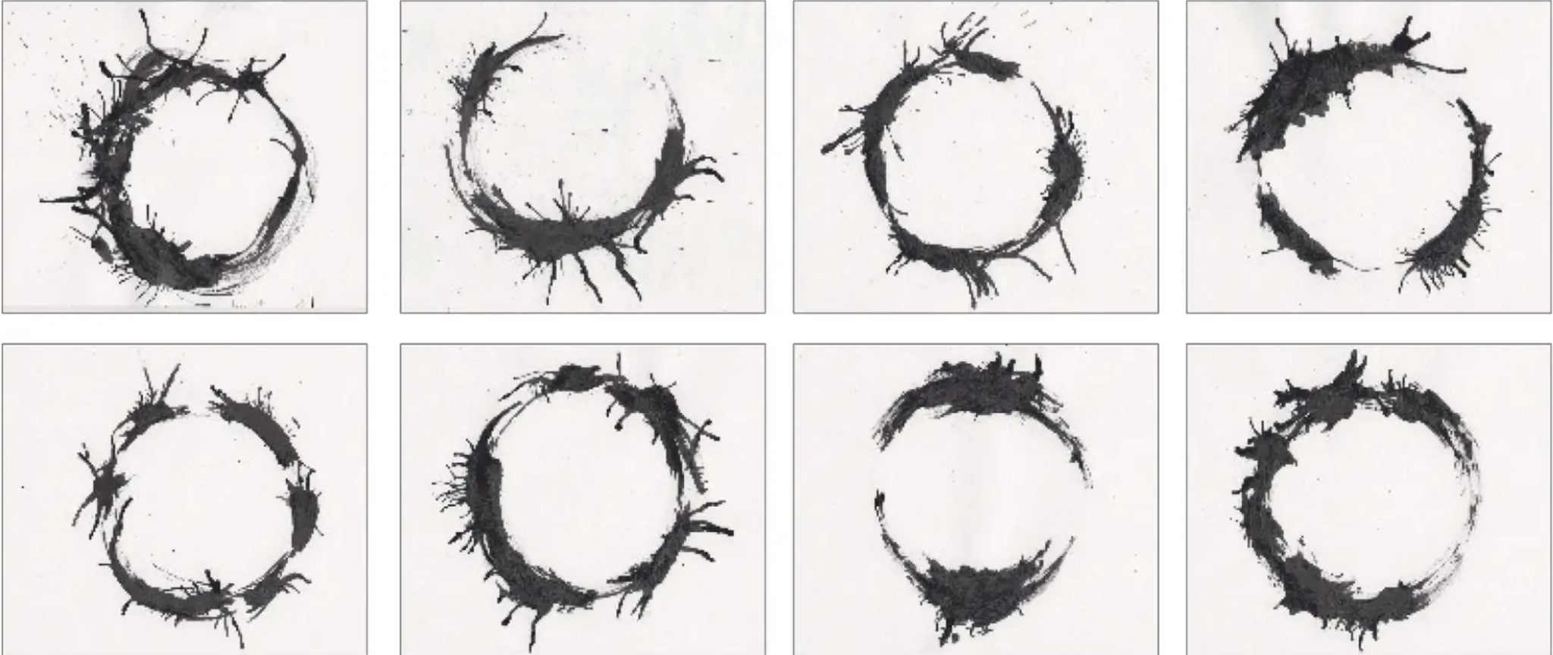

Observation
One notable similarity is the non-linear structure of the Heptapods writing in circular symbols. I notice the similarities of their structure to a current language. Each image was represented in a very complex manner, expressing in a whole rather than a linear sequence. This mirrors some aspects of Chinese, where characters usually convey meaning through spatial arrangement.

Slide 6



Reflection/Implications for NLP
This resonates very well with NLP, reflecting the influence of language structures and importance of context. In NLP, this aligns with the growing emphasis on contextual language models like GPT-3, which has given humans a way to reshape our understanding of communication just like Louise and the others did learning to speak with the Heptapods.

Slide 7
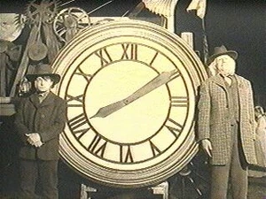
Reflection/Implications for NLP (future)
The Sapir-Whorf hypothesis is the heart of the movie.
Circular Language.
MultiModal Communication
Ethical aspects
Notes:
The Sapir-Worf hypothesis (coined by Lee Whorf and Edward Sapir) states that language does not only serve for expressing thought, but it influences or determines our perception. Their conclusion was based on a study of Eskimos and how robust their vocabulary was simple snow.
Currently we perceive language in a linear form – a beginning and an end, but the alien’s language was circular. Louise must change her perception from linear to circular which shaped her perception of the world. What would this do to our models?
The alien’s language uses both written symbols and visual patterns, can we create models that take both written symbols and visual patterns?
Ethical aspects – if language affects our perception – how do we keep any biases from influencing those perceptions.

Slide 8

WRAPPING IT ALL UP
Relevance to NLP: "Arrival" serves as a metaphor for the complexities and challenges in the field of Natural Language Processing. It parallels the tasks of translating unknown languages, understanding context and cultural nuances, and the evolving nature of AI-based communication technologies.
Linguistic and Cognitive Challenges: The movie presents a unique perspective on the linguistic and cognitive challenges of deciphering an alien language, showcasing the intersection of linguistics, cognitive science, and communication theory. It raises questions about how language influences perception and reality.
Exploration of Human and AI Interaction: The film's narrative offers insights into the future of human and AI interaction, particularly in the realm of language translation and communication. It prompts a reevaluation of our approaches to AI and the potential for more intuitive, context-aware systems.

Slide 9
References
Chaudhury, P. (2020, June 21). Arrival: A non-linear perspective on Time. Medium. https://catplotlib.medium.com/arrival-a-non-linear-perspective-on-time-10e53c319cd3
YouTube. (2016, November 12). Arrival movie’s language: Talking in circles. YouTube. https://www.youtube.com/watch?v=Qd8zT1YAUck
Lewin, S. (2016, November 21). “arrival”, ai and alien math: Q&A with Stephen Wolfram. Space.com. https://www.space.com/34783-stephen-wolfram-arrival-interview.html

Slide 10

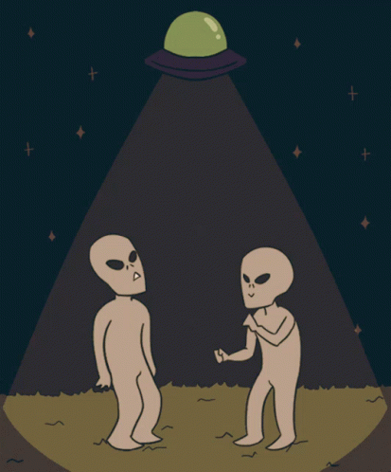
Thank you
Team Members:
Gabrielle Marshall (Manager)
Bryanna Wallace
Daniel Wright
Patrick Pacheco
Winston Lee

